Slide 1
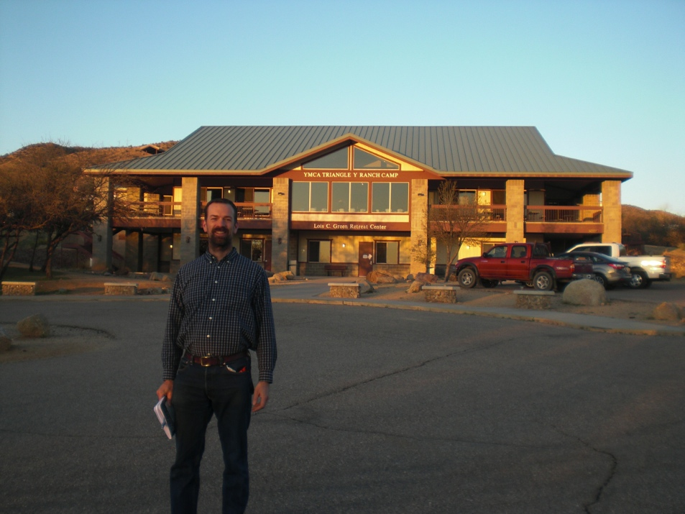
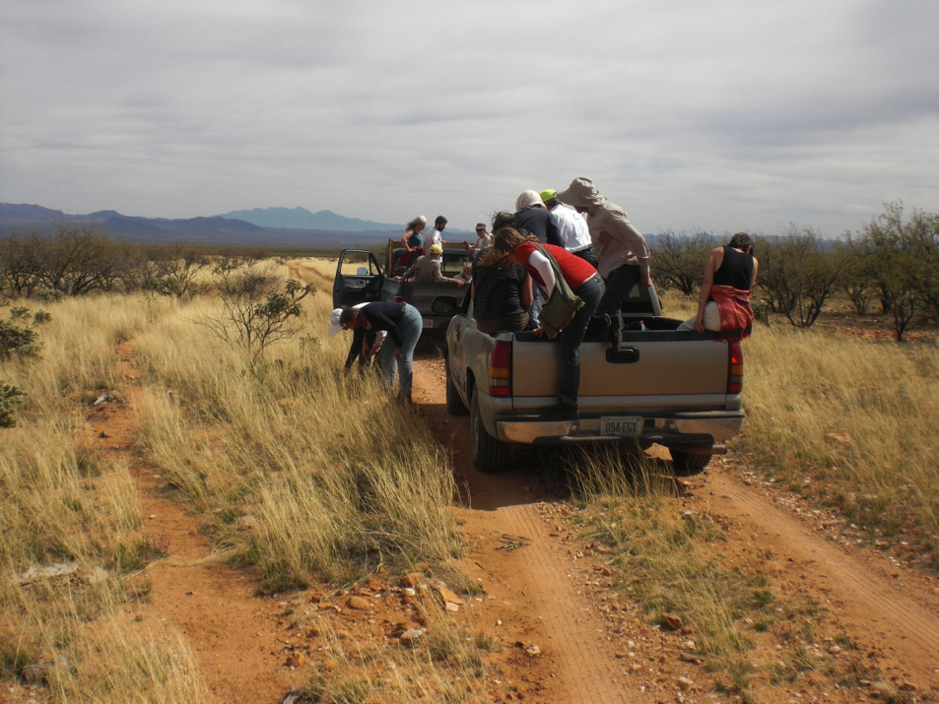
2012 Organic Beekeeping Conference in Oracle, AZ

Slide 2
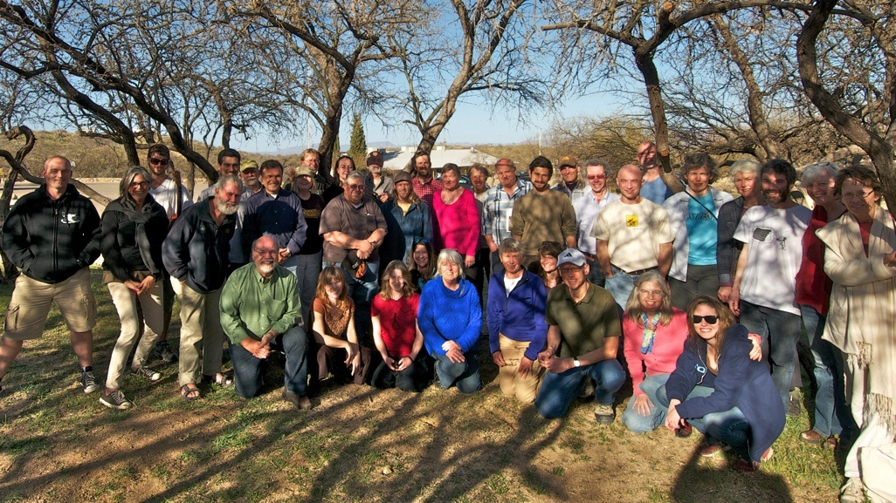
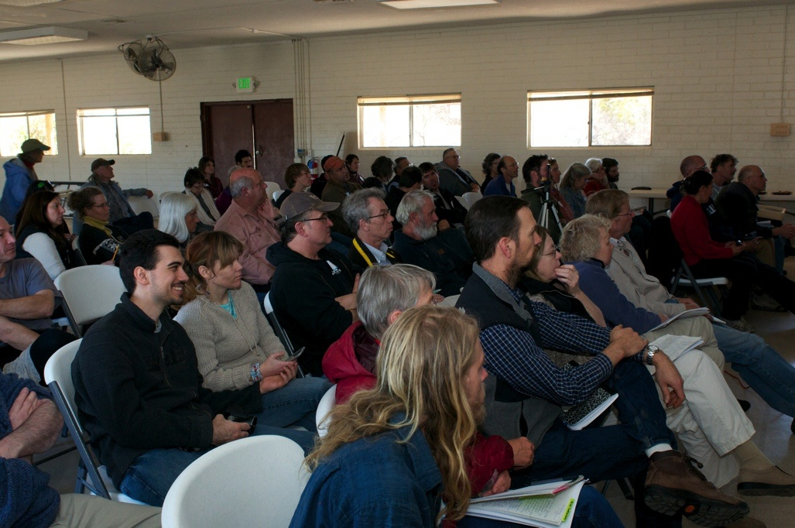
Oracle Conference
YMCA camp
6 bunk rooms; Dorm style food
Beautiful location
Camaraderie of alternative beekeepers
4-5 year veterans & experienced presenters
All represented
Teens through retirees
Sideline beekeepers through full time careers
Shoestring budgets through cash rich hobby
Dee Lusby apiary visit

Slide 3
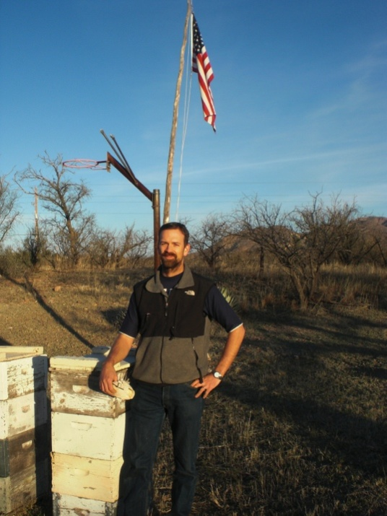
How dirty is your bee suit?
Nathan has achieved the “brown belt” equivalent of beekeeping since 2009.
Next: “black belt”
Skipped (for better or worse…)
Splits
Combines
Lost queens
Failed queens
Chilled brood
Hot hives
Swarms collected
Bad swarm collections
Top bar hives
Screened bottom boards
Observation hives
Varroa mite observations
Foundationless
Starving hives
Robbing hives
Dry sugar feeding
Sugar syrup feeding
Internal hive feeding
External hive feeding
Crystallized honey feeding
Honey feeding on the bottom board; inner cover; mason jar style
Bait hives (unsuccessful)
Lost swarms
Crush & strain harvesting
Propolis collection
Wax collection & rendering
Candle dipping
Wasp, Hornet, Bumble bee removals
Wasp cut out s from buildings
Swarm cut-out
Package installation
Direct release requeening
Failed combines
Sugar mists
Water mists
Smoke applications
Top bar hive construction
Burr comb from open spaces
Mentoring others
Swarm capture demonstrations
Neighborhood interactions
Informal education discussions
Teaching kids
Web site blogging
Attending conferences
Reading periodicals & books
Queen includers
Club participation
Mason bees
Knowledge of local nectar flow season
Regression
Treatment free mentor sources
Queen breeding (more than rearing)
Large scale honey harvest
Large scale propolis harvest
Large scale wax processing
Honey bee cut outs
Become bee provider (nuc sales)
Queen provider (predictable results)
Formal presentations
Sales & marketing
Drumming a swarm to move it
Baiting swarms
Unlimited Brood Nest success
Working hives without gloves
Apply my own apitherapy
HFCS
Large Cell foundation
Formal certifications
Migratory hives (pollination/Fireweed)

Slide 4
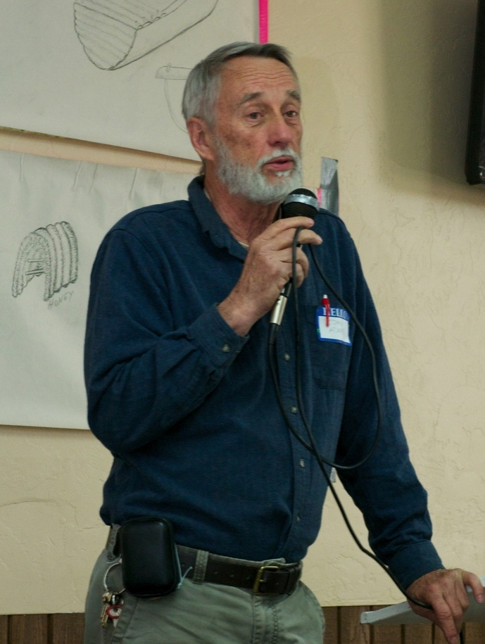
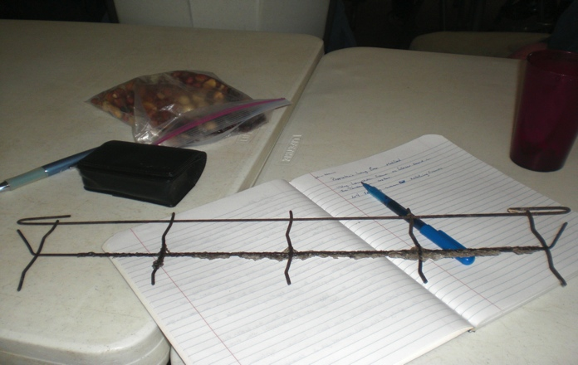
John Adams
Success of the American Long Box
Top Bar Hives
Flexible solutions to design, feeding, & maintenance
Swarm ketching frames
Wire top bars
Open bars w/feeding trays above
TBH need to be deep for temperature regulation
Book speaks at length of Poppleton’s hive
Based in Richmond, VA
Spoke to the many places he has removed feral hives
Shared his own collapse and recovery experiences
Historically honey was considered a gift only, and rarely sold for cash income

Slide 5
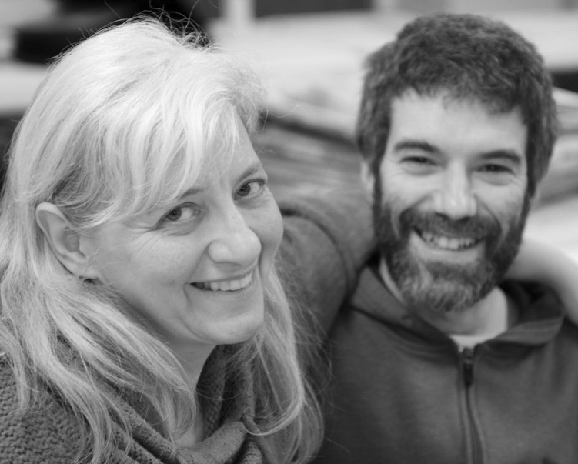
Dean Stiglitz
Honey bee genetics
Haploid reproduction; drones & queen genetics
Half sisters in the hive
Selected queen cells maintained by “sub-castes” within the worker population
Queen cells selected by the bees based on the current need of the hive. (spring vs. summer stresses

Slide 6
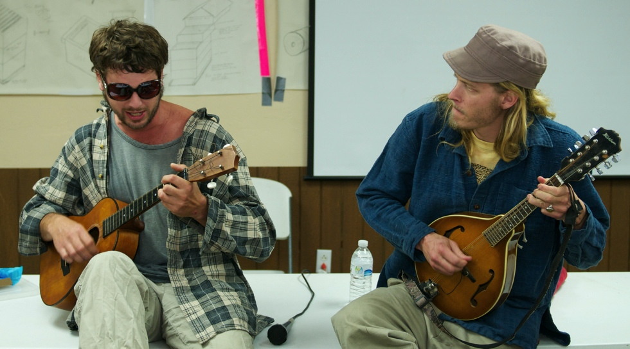
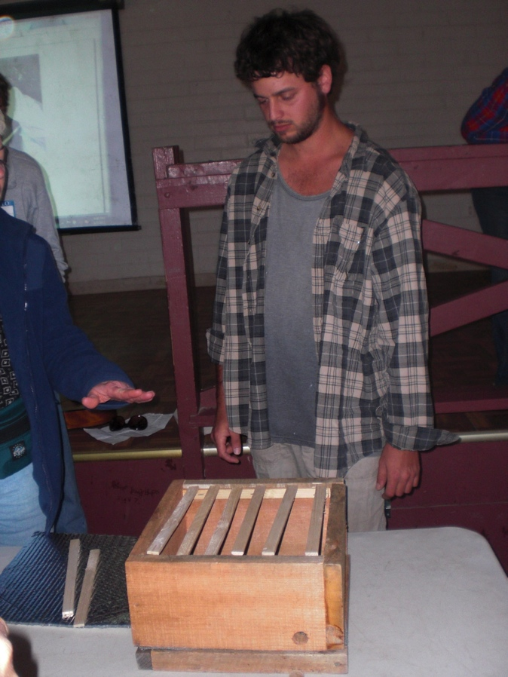
Sam Comfort
http://anarchyapiaries.org/
Shared his experiences in how he got to where he is now
Description of treadmill slavery of commercial beekeepers
Treatments & migratory pollination work with the debt/work cycle
Shared bad experiences with migratory beekeeping & colony collapse losses
His own collapse and recovery experiences
Runs 500 TBH’s in Upstate New York, and also Florida
Works in queen breeding to develop a northern hardy strain
Understands breeding genetics, so that winter splits made in the south can still provide drones when the hives are moved north
Examples of hygienic behavior
uncapped brood; half eaten brood (photos)
Head butting small hive beetles away while in flight outside the hive

Slide 7
Sam Comfort
Demonstrates simple solutions to equipment
TBH made with scrap lumber
No lid for NY winters; bees use propolis to seal the bars together against water intrusion
Trash bags of leaves used for winter insulation
Small sheet of masonite held in place with bungee cord as “roof”
Warre nucleus hive = four 1 x 8 x 12” boards, 4 screws = $0.80 investment; light sticks for top bar; perpendicular top bar to separate comb between boxes.
The single most important thing to do to ensure hive health:
Let them swarm!
Break in the brood cycle
New location/new wax refreshes the “liver of the hive”
Encourages locally successful queens & bees.
Honey is too valuable to sell, so he gives it away
Wax is the liver of a hive; rotate it out for healthy detoxification
2012 Almanac
Good to share!

Slide 8
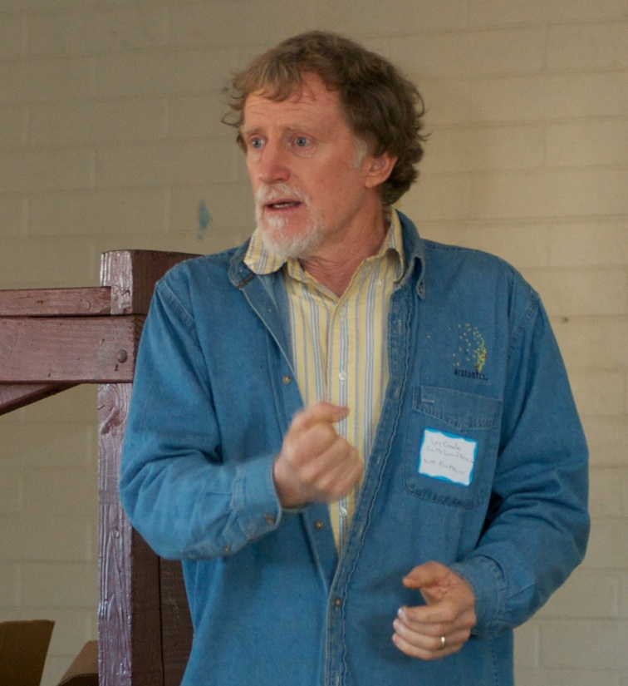
Les Crowder
New Mexico top bar beekeeper
Signed contract with Chelsea Green Publishers for new book on Top Bar Beekeeping
Reviewed photos from the book
I’m buying it as soon as it comes out
http://www.fortheloveofbees.com/
TBH management
Round drum TBH; 30° angle where bottom comb is no longer attached = honey bee hexagonal shape TBH. **duh**
Workers will not cross over a filled bar of honey
Results in swarming
Practical approaches to splits & honey concentration in selected hives
Comb rotation & management to facilitate hive growth or honey gathering
Value of treatment free wax (herbalists)
Value of treatment free propolis (herbalists)

Slide 9
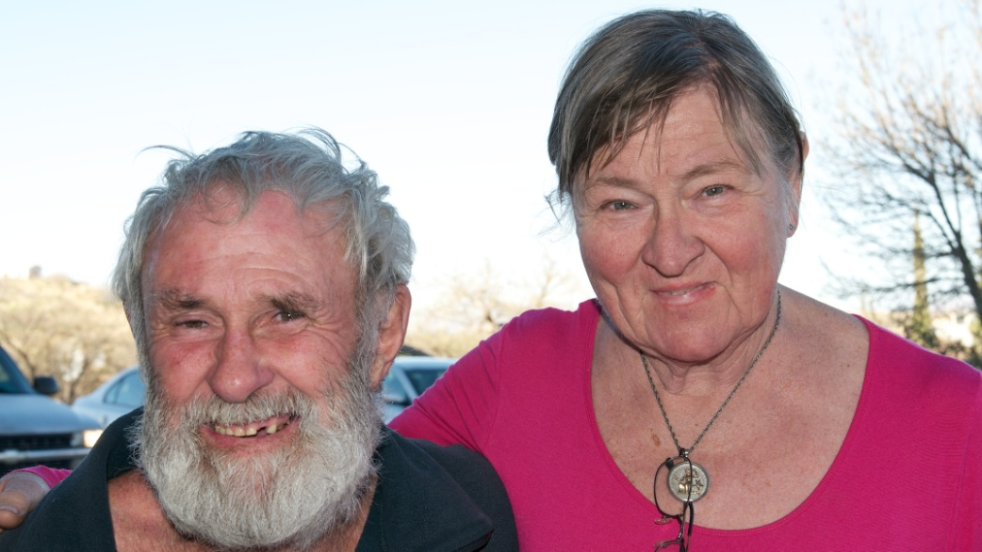
Roy Arbon
New Zealand
Queen of the Sun movie
Only treatment free beekeeper in New Zealand
New Zealand beekeeping
Isolated
Varroa arrived several years ago
American Foul Brood arrived several years ago
Collapse and recovery cycle just now beginning
Unique beekeeping environment
large nectar flows; when the weather permits
Valuable Manuka honey; when it happens
He is supplying small cell foundation to New Zealand with his own foundation mill

Slide 10
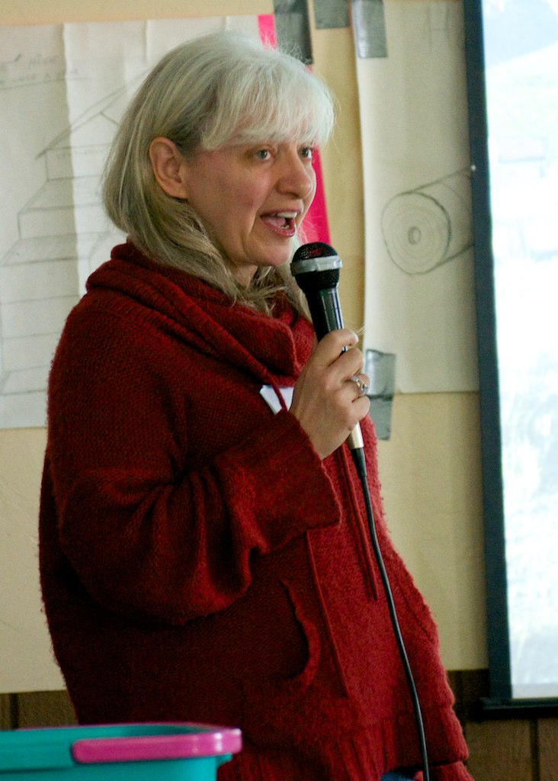
Ramona Herboldsheimer
Microbiology in the beehive
Pollen is fermented/pickled into bee bread
Strains of bacteria are only found in the honey bee
Balance between fungus, bacteria, yeasts, & viruses
Stone brood fungus is what is used to produce fumagillin, the treatment for nosema (a bacteria overgrowth)
Treatments eliminate/remove one of these factors, open the door for overcorrection by the others.

Slide 11
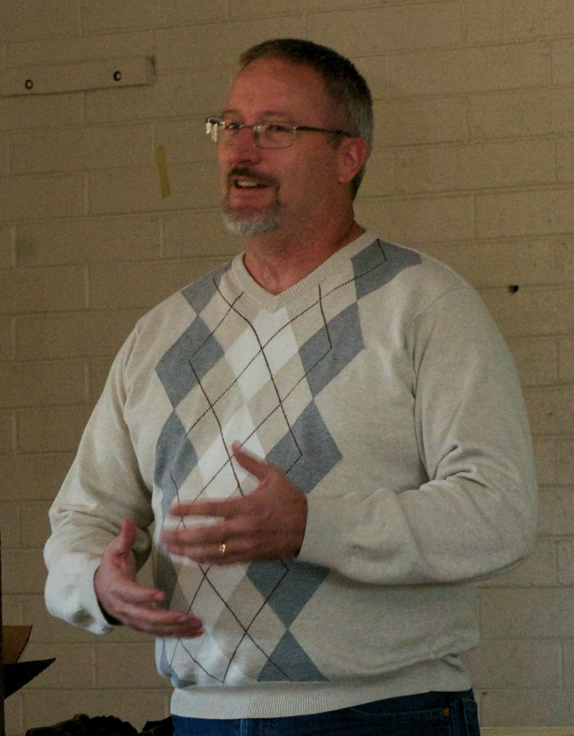
Howard & Martha Herbert
Warre hives in Phoenix
~15 hive count; no business plan yet—sideline beekeeper
Host locations on “estate” sized lots to avoid neighbor problems
Their approach has been with minimal time investment; best overall return
Howard builds all his own woodenware
Hive lift used to “nadir”
Fiber optic camera used to inspect bottom box (prevents hauling out the 80# lift from the pickup)

Slide 12
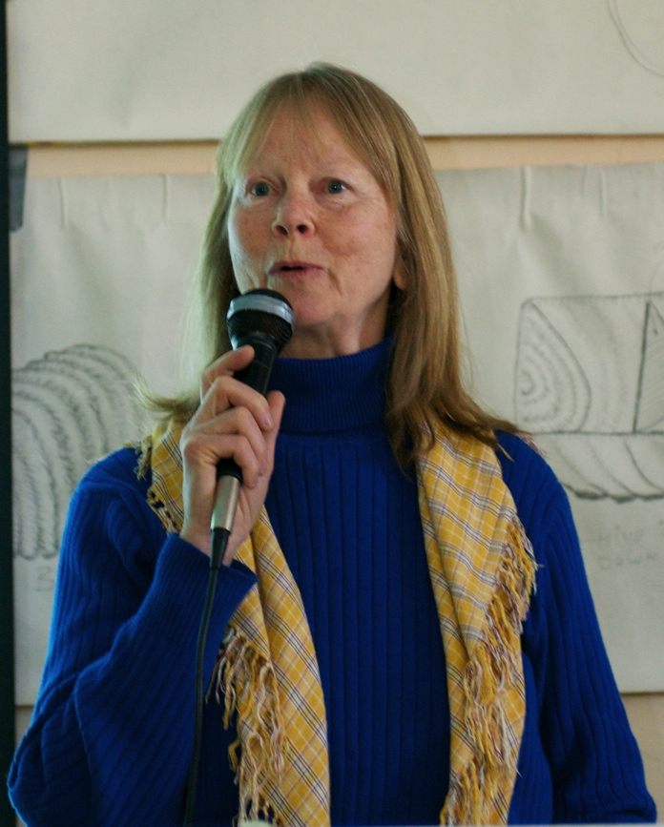
Jacqueline Freeman
http://www.friendlyhaven.com/
Featured in Queen of the Sun movie
March 31st presentations in Snoqualmie
Bees can tell us a lot of what they need
Creatures of the sun & sky; keep them up off the ground (i.e. a stand)
Space below the hive as a “fall away” for detritus & waste is important
Drumming a swarm off of a branch example story
Pesticides, treatments, stresses to the brood nest (chilling & vibration from inspections) cause less than optimal bees. Compare to mild autism.
Inspecting honey frames is acceptable if done with respect
Brood nest is sacred, and opening it and inspecting it should not be done without reservation.

Slide 13
Don Downs
Apitherapy in Ohio
A work of love for those he helps
Sideline job
Bee products (pollen, propolis, wax & products from them)
Micro-stings
Full stings (1 – few per treatment)
“both barrels” working up to 30 stings
Many, many successes; including paralysis from a broken spine in a dog
No insurance
www.apitherapy.org

Slide 14
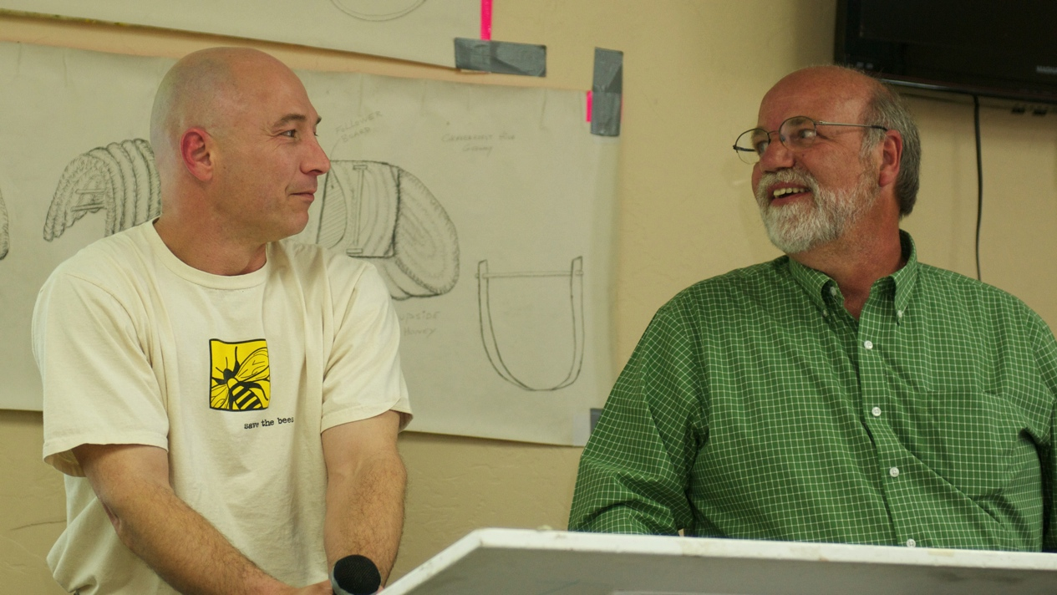
Bill Walter & Dwight Detter;
http://www.guerillabeekeepers.com & Whole foods market
Marketing & business planning
Feral bee removal business is booming in Southern California
Honey sales to Whole Foods under Local Foods push
Hive rental ($100/first; $75/additional; Free if 5 hives are placed in your yard)
2nd season & looking for employee to help with the work

Slide 15
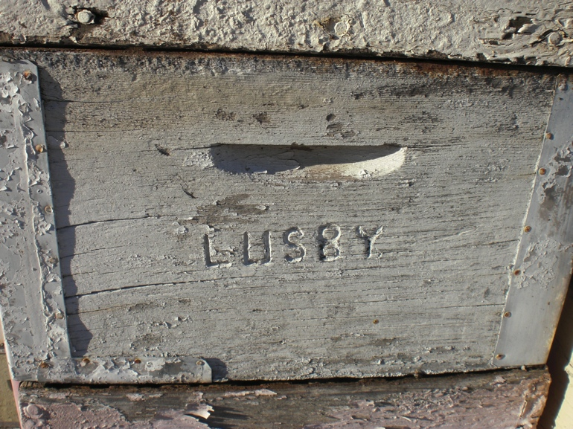
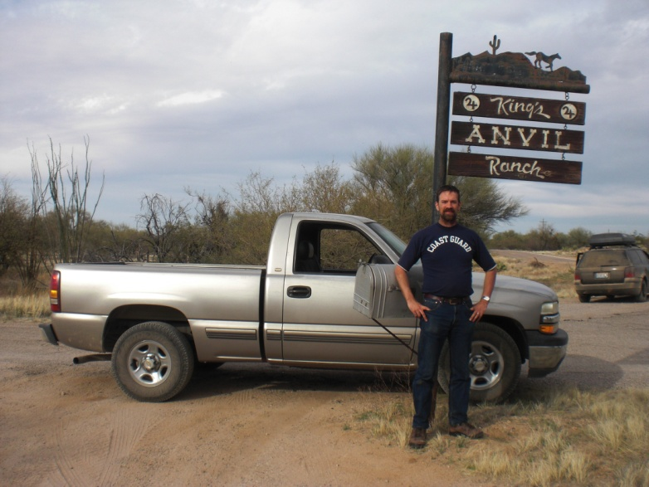
Significant Points
There is a lot of opportunity & support out there
Crash and recovery cycle; We’ve all done it.
90% loss 1st year
50% loss 2nd year
Less than 25% loss 3rd year
Less than 10% loss after that
New Zealand just started that cycle in the past 2 years
Feral Bees
Booming in Deep South & Southern CA (more than 6 hives per square mile)
I predict this trend will work north
Honey is too valuable to be sold. It was only given as a gift.
Wax is the liver of the hive
Rotate it out for “toxic cleanse”
Simple works; often better than normal; Anarchy Apiaries 2012 almanac
Trust the bees to naturally balance themselves
Respect the brood nest
Let them swarm; raise your own queens

